Slide 1



Trade Liberalization and Mergers in the North American Malting Industry
Derek Brewin, Richard Gray and Giannis Karagiannis
November 25th, 2011
Structure and Performance of
Agriculture and Agri‐products Industry (SPAA)
Ottawa, Ontario

Slide 2
What are the Welfare Impacts of Mergers with Free Trade?
Does this persist with further consolidation?

Slide 3
Some Previous Work
Azzam, A ., and J. Schroeter. 1995. Tradeoff between Oligopoly and Efficiency: Beef Packing. AJAE.
Fjell, K., and D. Pal.1996. Mixed Oligopoly in the Presence of Foreign Firms. CanJEc.
Buschena, D.E. and R.S. Gray.1999. Trade Liberalization and International Mergers: Barley Malting in North America. RevAgEc

Slide 4
Buschena and Gray
MC_{i} = e + c_{i}X_{i} Plant level Marginal Cost
p_{ms}(X) = a – bX Demand for Malt Services
X_{i} = a – b(X_{-i}) – e . Optimal X_{i} Cournot
2b + c_{i}

Slide 5
Free Trade
Plant Marginal Cost – unchanged.
Market demand now for Canada and U.S.
Total quantity in market increases

Slide 6
Merger
Plant Marginal Cost
  assumed unchanged, but merged plants set MC of all plants equal
  decreases total cost
Price Behaviour
  increases own firm pricing power
  decreases number of firms
  price of malting services increase as does malt
  barley prices fall

Slide 7
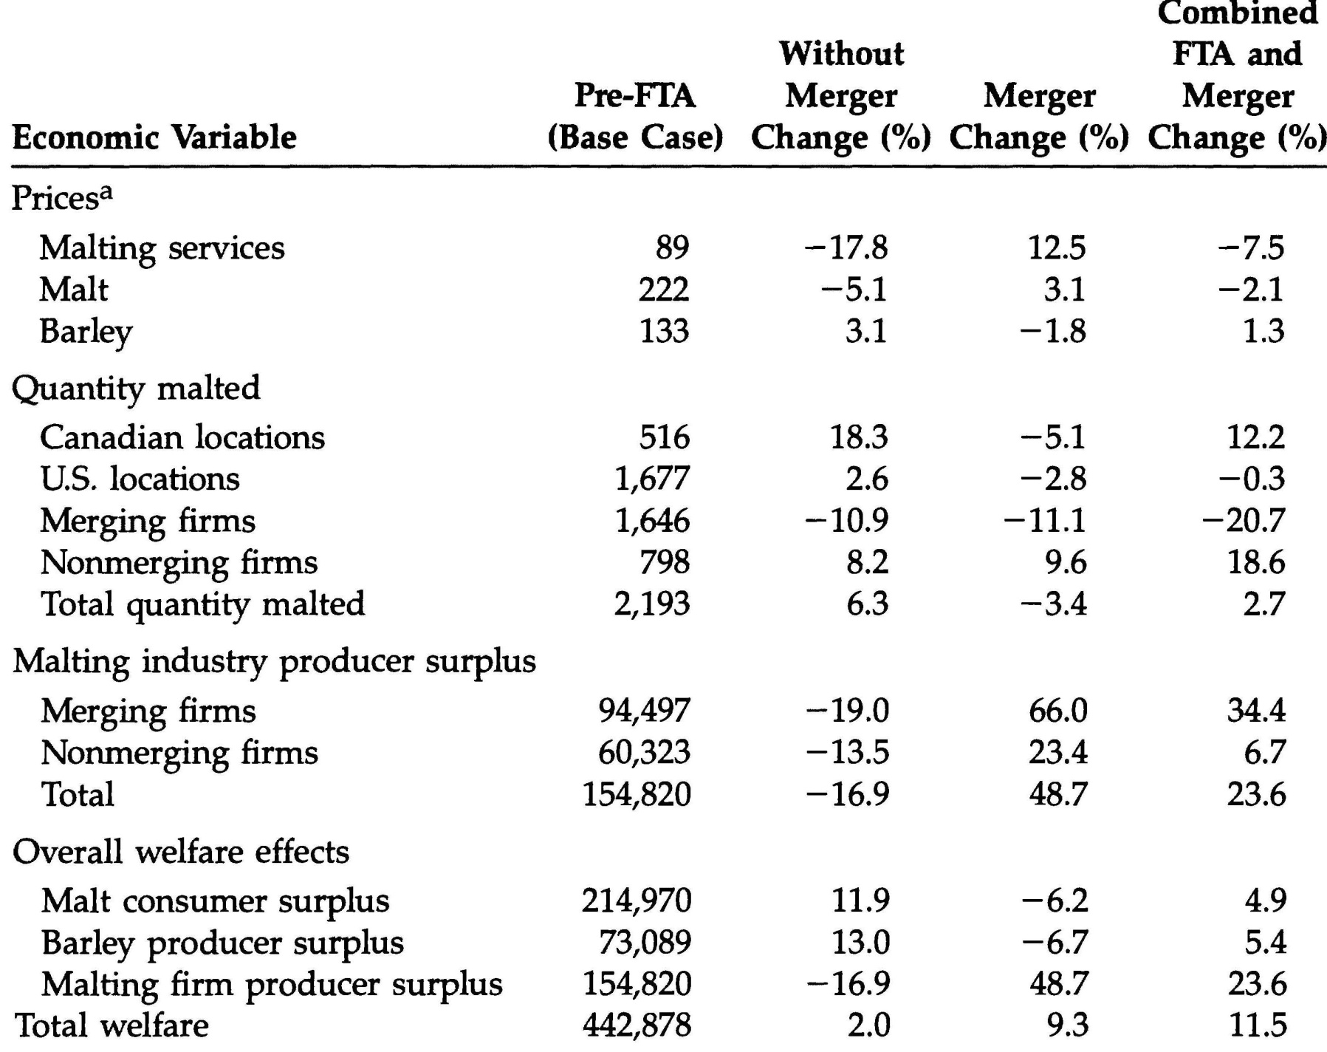
Buschena and Gray

Slide 8
Buschena and Gray
4 Canadian, 7 U.S. malting firms become 4 Can/US mergers and 3 US independents.
Free Trade increased Competition
Merging decreased total costs – but lowers welfare to barley suppliers and malt users
Total welfare impacts positive – free trade gains and cost savings are greater than barley and malt losses to market power

Slide 9
What Happened? Total Q

Slide 10
What Happened? Trade

Slide 11
What Happened? Barley

Slide 12
Sensitivity to Market Power Assumptions
Changes to Buschena and Gray.
Using pure Cournot current plants had negative slope to cost curves
We check for ‘less’ market power effects
X_{i} = a – b(X_{-i}) – e θ = change in total X_{-i} (2+θ)b + c_{i} expected by change X
θ = 0, Cournot; θ =-1 Competitive

Slide 13
What Happened? Plants
Simulated Firm Level Effects of the Free Trade Agreement and Mergers (θ = -0.1).
Sources: pre-CUSTA: Buschena and Gray; current size: First Key, Marginal Cost Authors

Slide 14
What Happened? Welfare θ =-0.1

Slide 15
What Happened? Welfare θ =-0.9

Slide 16
Conclusions/Implications
Recent mergers have not offset gains from trade
Mergers have redistributed gains from trade back to Malting firms
Seed work on Malting Firm bargain with Brewer and Spatial effects of Barley supply
Price/cost data?

Slide 17
Thank You!
Comments and questions are most welcome.

