Slide 1
Private Label and National Brand Pricing
and Promotional Strategies in Canadian Food Retailing
Waseem Ahmad
and
Sven Anders
REES, University of Alberta
Notes:
Other reasons for innovation failure are:
High introductory prices
uncompetitive products that are of low quality or insufficiently
innovative
failure to develop niche markets

Slide 2
Motivation & Purpose
Rapid growth in market shares of Private Label (PL) product lines across consumer packaged goods (CPG) categories
Increasing PL differentiation into high-quality product categories (e.g. organic, premium, ready meals)
Canadian consumer perceive little quality difference between established NBs and newly introduced PLs
Little empirical evidence of pricing and promotional competition in Canadian grocery retailing
Strategic value of PLs to Canadian retail chains
Retail pricing and promotional behaviour in response to emerging consumer demand
Lead question…

Slide 3
Objectives
Quantify the competitive interactions of PLs and NBs in selected differentiated CPG categories
Test whether health-attribute product differentiation affects PL-NB competitive interactions in pricing and promotional strategies
Quantify key retail PL behavioural parameters of price setting, promotional strategies and frequencies, and price rigidity

Slide 4
Past Literature
PL–NB game theoretical analyses: Raju et al (1995); Narasimhan/Wilcox (1998); Cotterill/Putsis (2001); Wu/Wang (2005); Karray/Herran (2009); Chen et al. (2010) → Introduction of PLs benefits retailer
PL Strategic Pricing and Demand: Sethuraman (1995); Cotterill/Putsis (2000); Ailawadi/Harlam (2004); Akbay/Jones (2005); Du/Stiegert (2009) Meza/Sudhir (2010); Richards et al. (2010) → PL pricing sign. affects NB market share
PL Promotions: Huang et al (2003); Muller et al. (2009); Ailawadi and Harlam (2009); Volpe (2010) → PLs promoted competitively with NBs to maintain/expand PL market shares during NB promotions. Promotional frequencies (and market concentration) determine PL/NB price relation
PL Quality: Appelbaum et al. (2003); Hassan/Monier-Dilhan (2006)

Slide 5
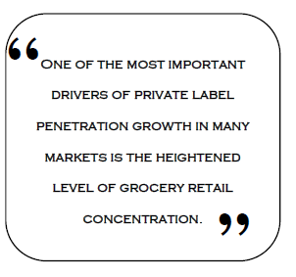
Private Label Continuum
 | 1st Generation | 2nd Generation | 3rd Generation | 4th Generation
Type | Generic CPGs | Quasi-Brand | Umbrella Brand | Differentiated Brand
Strategy | -Low volume, low quality CPG -Increase margin -Competitive pricing | -Countervailing power (NB) -Increase margin -Average quality CPG -Competitive pricing | -Max. category margins -Product differentiation -Quality/image equality (NB) -Quality-based pricing | -Customer loyalty -PL sub-brands -Equal/superior quality (NB) -Brand purchase criterion
Attribute | Price | Price | Value | Brand

Slide 6
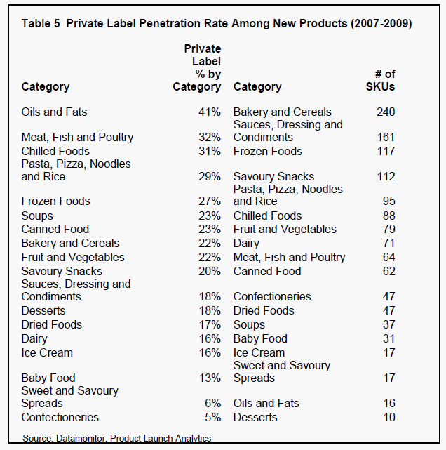
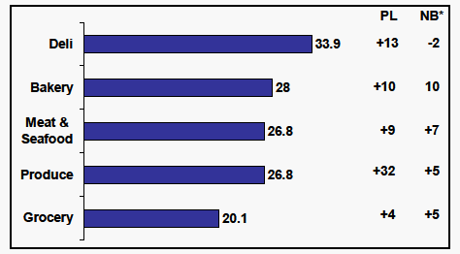
Private Labels in Canada

Slide 7
Case Study Analyses
PL-NB Competition in Health-differentiated Food Product Categories
Sliced Packaged Bacon
Commercial Fresh Bread/Toast
Hot Breakfast Cereals
NEIO oligopoly model of PL-NB category-level market share competition using price as the strategic variable
Game theoretical model of strategic PL-NB pricing interactions using Roy et al.’s (2006) Non-Nested Model Comparisons (NNMC) approach
Related work: peanut butter, salad dressing, granola bars

Slide 8
Data
Proprietary weekly store-level scanner data w01/2004 - w27/2007
Major US-Canadian retail chain
SIEPR-Giannini Data Center, Stanford University
Data Structure
UPC | UPC Categories | Stores CAN (US) | Time | Sales
>40,000 | 200 | 269 (1928) random sample: BC, AB, MB, SK, ON | 183w aggregate promo (y/n) | net revenue gross revenue qty or quant AGP= sales + allowance -product cost unit cost to retailer
description entry-exit | food, non-food | location, size, banner

Slide 9
Share Rankings and Trends
Region Division | PL_{H} | PL_{R} | NB_{H} | NB_{R} | Trend
 |  |  |  |  | PL | NB
Calgary | 2/3 | 4 | 3/2 | 1 | flat | +
Winnipeg | 2 | 4 | 3 | 1 | - | +
Victoria | 3/2 | 4 | 2/3 | 1 | flat | flat
Ontario | 2 | 4 | 3 | 1 | - | +
Saskatoon | 3 | 4 | 2 | 1 | - | +
NB_{R} market leader in all areas
PL_{H} and NB_{H} in close constant market share competition

Slide 10
Brand Promotional Interactions
Division ”East” (Winnipeg) |  | (PL)
 |  | Promo | No promo | Total
NB | Promo | 29.19 (25.47) | 22.98 (27.33) | 52.17 (52.80)
 | No Promo | 22.98 (16.15) | 24.84 (31.06) | 47.83 (47.20)
 | Total | 52.17 (41.61) | 47.83 (58.39) | 100 (100)
Division “West” (BC) |  | (PL)
 |  | Promo | No promo | Total
NB | Promo | 25.47 (16.77) | 27.95 (37.89) | 53.42 (54.66)
 | No Promo | 14.91 (6.21) | 31.68 (39.13) | 46.58 (45.34)
 | Total | 40.37 (22.98) | 59.63 (77.02) | 100 (100)

Slide 11
Model
NEIO model of category-level oligopolistic market share competition between retailer (PL) and NB manufacturers using price a the strategic variable
Approach extend based on Cotterill and Putsis (2000):
𝑸^{1, 2}_{𝒊j} = 𝒇(𝑷_{𝒊}, 𝑷_{𝒋},D)
𝑴𝒂𝒙 𝝅^{1,2}_{𝒊j} = (𝑷_{𝒊}∗𝑸_{𝒊}−(𝑴𝑪)_{𝒊}∗𝑸_{𝒊}), with i = 1, 2,…, n
(𝝏𝝅_{𝒊j})/(𝝏𝑷_{𝒊j}) = 𝒇_{𝒊}(𝑷_{𝒊}, 𝑷_{𝒋},D, (𝑴𝑪)_{𝒊})
𝑷^{1,2}_{𝒊j} = 𝒈_{𝒊} (𝑷_{𝒊}, 𝑷_{𝒋}, D, (𝑴𝑪)_{𝒊}
Retailer unit cost observed
Joint GMM estimation of PL-NB brand share demand System (LA/AIDS) and log-linear price reaction functions (Kadiyali et al. 1996)
S^{1,2}_{ij} = α₁₀ + α₁₁ lnP¹_{ij} + α₁₂ lnP²_{ij} + α₁₃ ln(E_{ij}/P_{ij}) + α₁₄D_{ij}

Slide 12
Descriptive Stats – Bacon
 |  | Price Difference NB/PL ($) |  | Retailer Margin ($) |  | Difference Between Promotional Frequency and Depth in NB and PL
 |  | Shelf Price | Promo Price | PL | NB | Promo Freq. (%) | Promo Depth*
Alberta | Reg Bacon | 3.48 | 2.63 | 1.39 | 3.24 | 25.47 | 0.85
 | H Bacon | 1.06 | 0.65 | 2.94 | 3.23 | 4.97 | 0.41
West division | Reg Bacon | 3.55 | 2.55 | 1.75 | 3.68 | 31.68 | 1.00
 | H Bacon | 1.10 | 0.60 | 3.34 | 3.68 | 13.05 | 0.49
Saskatoon | Reg Bacon | 3.39 | 2.58 | 1.44 | 3.21 | 28.58 | 0.81
 | H Bacon | 0.97 | 0.60 | 3.00 | 3.20 | 11.19 | 0.37
Ontario | Reg Bacon | 3.22 | 2.42 | 1.56 | 3.16 | 29.82 | 0.80
 | H Bacon | 0.91 | 0.57 | 3.00 | 3.15 | 5.59 | 0.34
East division | Reg Bacon | 3.43 | 2.58 | 1.44 | 3.24 | 11.19 | 0.85
 | H Bacon | 1.02 | 0.61 | 2.99 | 3.24 | 0.00 | 0.41
* Promotional Depth = % discount NB - % discount PL

Slide 13
Results
 | Demand Equations |  |  |  | Price Reaction Functions
 | PL R | PL H | NB H | NB R | NB R | PL R | NB H | PL H
Constant | 0.569 (4.30)* * | 0.181 (1.10) | 0.627 (2.24)* | -0.376 (-0.83) | -0.054 (-10.59) ** | -0.198 (-3.11) ** | 0.030 (5.41) ** | 0.788 (12.11) **
NB Price R | 6.931 (10.72) ** | 1.571 (2.82) ** | 14.116 (9.83) ** | -22.618 (-9.87) ** |  | 2.517 (12.17) ** | 0.985 (730.56) ** | -0.464 (-5.52) **
PL Price R | -0.213 (-5.27) ** | -0.029 (-0.70) | 0.024 (0.31) | 0.218 (1.70) * | 0.050 (10.02) ** |  | -0.031 (-5.62) ** | -0.519 (-11.76) **
NB Price H | -6.951 (-10.26) ** | -0.569 (-0.95) | -13.825 (-9.16) ** | 21.344 (8.88) ** | 0.993 (763.63) ** | -2.283 (-11.17) ** |  | 1.479 (17.84) **
PL Price H | 0.036 (1.001) | -0.948 (-21.39) ** | -0.375 (-4.51) ** | 1.287 (10.27) ** | 0.005 (3.11) ** | -0.099 (-6.09) ** | 0.016 (9.67) **
Expenditure | -0.026 (-5.03) ** | 0.023 (4.03) ** | 0.016 (1.54) | -0.013 (-0.75)
D PL R Prom | 0.013 (2.87) ** | 0.021 (4.38) ** | 0.017 (1.74) * | -0.051 (-3.57) **
DNB R Prom | 0.267 (4.27) ** | 0.105 (2.40) * | 0.639 (4.23) ** | -1.010 (-4.33) **
D PL H Prom | 0.002 (0.28) | -0.103 (-8.54) ** | -0.150 (-7.12) ** | 0.250 (7.84) **
D NB H Prom | -0.312 (-4.46) ** | -0.013 (-0.24) | -0.533 (-3.20) ** | 0.858 (3.33) **
PL Share |  |  |  |  | 0.001 (1.72) * | -0.469 (-8.61) ** | 0.043 (35.29) ** | -2.142 (-37.21) **
Herfindahl Index |  |  |  |  | -0.005 (-19.74) ** | 0.119 (7.14) ** | -0.035) (-23.66) ** | 1.352 (20.72) **
Retailer Cost |  |  |  |  | 0.000 (-1.21) | 1.767 (29.78) ** | 0.002 (5.75) ** | 0.027 (7.71) **

Slide 14
Results – Shifters
 | Demand Equations
 | PL R | PL H | NB H | NB R
Population | 0.000 (-0.001) | 0.000 (7.12) ** | 0.000 (2.59) ** | 0.000 (-3.93) **
Immigrant | 0.000 (-1.06) | 0.000 (-4.86) ** | 0.000 (-0.76) | 0.000 (2.32) *
Income | 0.000 (-3.86) ** | 0.000 (-6.24) ** | 0.000 (-5.36) ** | 0.000 (6.32) **
Calgary | 0.936 (1.72) * | 2.420 (3.75) ** | -0.024 (-0.02) | -3.333 (-1.66) *
Edmonton | 0.650 (1.85) * | 1.277 (3.07) ** | -0.439 (-0.55) | -1.488 (-1.15)
Vancouver | 2.844 (1.34) | 10.749 (4.24) ** | 1.419 (0.29) | -15.012 (-1.91) *
Abbotsford | 0.121 (1.57) | 0.317 (3.46) ** | -0.081 (-0.46) | -0.358 (-1.26)
Victoria | 0.241 (2.07) * | 0.470 (3.40) ** | -0.090 (-0.34) | -0.621 (-1.45)
Saskatoon | 0.044 (4.03) ** | -0.133 (-9.75) ** | -0.173 (-6.93) ** | 0.261 (6.76) **
Winnipeg | 0.417 (1.93) * | 0.726 (2.86) ** | -0.371 (-0.77) | -0.771 (-0.98)
Thunder Bay | 0.031 (3.03) ** | -0.034 (-2.79) ** | -0.121 (-5.32) ** | 0.125 (3.35) **

Slide 15
Demand Elasticities
 | Demand Equations
 | PL R | PL H | NB R | NB H
Price PL Reg | -3.67** | -0.12 | 0.44* | 0.12
Price PL H | 0.37 | -5.22** | 2.60** | -1.83**
Price NB Reg | 85.91** | 7.09** | -46.89** | 69.45**
Price NB H | -86.37** | -2.53 | 43.29** | -68.97**
Expenditure | 0.67** | 1.10** | 0.97 | 1.08
PL Reg promo | 0.04** | 0.03** | -0.03** | 0.02*
NB Reg promo | 1.78** | 0.25** | -1.10** | 1.69**
PL H promo | 0.01 | -0.21** | 0.24** | -0.34**
NB H promo | -2.04** | -0.03 | 0.92** | -1.38**
η_{ii} for NB reg driven by HiLo retailer strategy

Slide 16
Demand Elasticities
 | Demand Equations
 | PL R | PL H | NB R | NB H
Population | 0.00 | 4.99** | -3.84** | 3.85**
Immigration | -5.43 | -10.74** | 7.21* | -3.56
Income | -1.75** | -1.17** | 1.78** | -2.34**
Calgary | 0.98* | 0.91** | -0.57* | -0.01
Edmonton | 0.68 | 0.48** | -0.25 | -0.18
Vancouver | 2.96 | 4.04** | -2.55* | 0.59
Abbotsford | 0.12 | 0.12** | -0.06 | -0.03
Victoria | 0.25* | 0.17** | -0.10 | -0.04
Saskatoon | 0.05** | -0.05** | 0.04** | -0.07**
Winnipeg | 0.43* | 0.27** | -0.13 | -0.15
Thunder Bay | 0.03** | -0.01** | 0.02** | -0.05**

Slide 17
Conclusions
Increasing category-level concentration increases PL prices and lowers NB prices. The evidence suggest that retailers are able to establish PL brand loyalty and can effectively narrow the price gap to competing NBs as they raise PL prices to improve profitability.
PL promotion is an effective tool in PL-NB competition. Yet, demand is more responsive to NB price promotions.
Cross-price elasticities are decidedly asymmetric. NBs price has a distinct impact on PL sales. The reverse impact of PL price on NB demand is much weaker. This is consistent with Cotterill and Putsis (2000) and Allenby and Rossi (1991).

Slide 18
Private Label and National Brand Pricing
and Promotional Strategies in Canadian Food Retailing
Sven.Anders@ualberta.ca and Waseem@ualberta.ca
Resource Economics & Environmental Sociology
University of Alberta
Research Funding:
Alberta Livestock and Meat Agency
U of Alberta
SIEPR- Giannini

Slide 19
Descriptive Stats II
 | Alberta | West | Saskatoon | East | Ontario
Share PL Reg | 0.101 | 0.113 | 0.075 | 0.095 | 0.055
Share NB Reg | 0.472 | 0.431 | 0.433 | 0.481 | 0.549
Share PL H | 0.223 | 0.239 | 0.239 | 0.239 | 0.241
Share NB H | 0.204 | 0.217 | 0.253 | 0.185 | 0.156
Price PL Reg | 3.226 | 3.515 | 3.271 | 3.269 | 3.360
Price NB Reg | 5.853 | 6.063 | 5.848 | 5.851 | 5.778
Price PL H | 5.211 | 5.455 | 5.245 | 5.246 | 5.211
Price NB H | 5.864 | 6.060 | 5.844 | 5.856 | 5.782

