Slide 1
Sticky Retail Prices, Quality Differentiation & Private Labels
The President’s Choice
Milena Bocionek University of Giessen
Sven Anders University of Alberta
ERCA Research Network Workshop
Structure & Performance of Agriculture and Agri-products Industry
Ottawa, March 8, 2013

Slide 2
Private label shares across markets

Slide 3
Perceptions of PL quality

Slide 4
Evolution of vertical PL differentiation
Strategic positioning of PL brands
 | Generics | Me-too | Premium
Price | 20-50 % below NB | 5-25 % below NB | Close or higher
Quality | Standard quality | Close to NB | On par / superior to NB
Category | Basic functional | Strong NB presence | Retailer image forming
Packaging | Cheap, minimal | Imitate NB | Unique, source of differentiation
Advertising | --- | Frequent | Feature advertising, limited sales

Slide 5
Literature
Competitive impacts of PLs:
Economic significance to retailer (Steiner 2004; Ailiwadi and Harlam 2004)
Economic impact of PL introduction (Chintagunta et al. 2002; Meza and Sudhir 2010)
PL-NB competitive interactions (Cotterill et al. 2000; Steiner 2004; Bontemps et al. 2008; Volpe 2010),
PLs to exert bargaining power (Meza and Sudhir 2010; Morton and Zettelmeyer 2004)
Competitive impact of quality-differentiated PLs (Kumar and Steenkamp 2007; Bontemps et al. (2008)
Notes:
Major reason for PL is higher margin and bargaining against NBs!!!
Villas-Boas (2007, Rev Econ Stud) “The research plan of this paper is as follows: first, I estimate demand and use the estimates to compute price-cost margins for retailers and manufacturers under different supply models without observing wholesale prices. I then compare estimated price-cost margins with the price-cost margins estimated using components of marginal costs to assess the fit of these different vertical models and identify the best among the competing non-nested models.”

Slide 6
Literature
Determinants of price rigidity:
Differences in retailer strategic management (Owen and Trzepacz 2002)
the use of psychological pricing points (Blinder et al. 1998; Levy et al. 2011; Herrmann et al. 2009)
the costs of changing retail shelf prices (Levy et al. 1997; Owen and Trzepacz 2002; Blinder et al. 1998)
Cost of acquisition (AAC) (Besanko et al. 2005; Dutta et al. 2002; Chevalier et al. 2003; Kano 2007).
Notes:
Often proxies are used to incorporate the input costs. Several authors used data from Dominick´s Finer Food, the second-largest supermarket chain in Chicago. They computed the wholesale price as a weighted average of the amount the retailer paid for the inventory, i.e. average acquisition costs (AAC) .
the wholesale cost data do not correspond to the theoretical measurement, such as replacement cost or the last transaction price. The problem of such a measurement as a proxy is that a wholesale price cut today only gradually works itself into AAC as old, higher-priced inventory is sold off

Slide 7
Objectives
Do retailers follow pricing strategies (price rigidity) that reflect vertical differentiation of PLs vs. competing NBs?
To what extend do retailer pass-through changes product cost (aka manufacturer prices)? Does it differ between PLs/NBs? Quality levels? Product categories?
Do pricing strategies follow product specific, seasonal demand (supply) patterns?

Slide 8
Selected evidence
Research | Period | Category | Mean duration (min-max)
Powers and Powers (2001) | 1986-1995 | lettuce | 2.3 weeks (1.38-4.88)
Dutta et al. (2002) | 1989-1991 | Orange juice | - (1.63-3.77)
Eichenbaum et al. (2011) | 2004-2006 | 200 UPC cat. | 2.32 weeks (-)
Herrmann et al. (2005) | 1996-1999 | 20 brands | 12.8 weeks (6.5-115.6)
Herrmann et al. (2009) | 1996-1999 | Coffee | 5.2 weeks (2.0-13.1)
Weber (2009) | 1996-1999 | Cheese | 27.4 weeks (-)
Baumgartner et al. (2006) | 1996-2003 | Fresh foods | 6.7 months (-)
Hellberg-Bahr et al. (2011) | 2005-2009 | Organic dairy | (-) (12.0-25.4)

Slide 9
Determinants of price rigidity
Price change
retailer strategy
Price promotions
Price jumps
Price setting
Store concept
Location
Store size
Marketing, product
Package size
Brand
Manufacturer relation
Wholesale price
Distribution

Slide 10
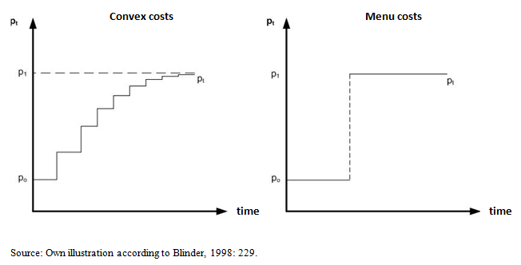
Theories of price rigidity
Price adjustment costs: high decision and information costs, direct costs of printing new leaflets or price tag changing
Price changes will be realized when the additional gains will exceed the price adjustment costs.
Notes:
Niehans lacks to include cost of adjusting prices. Work by Blinder et al. 1998.
Cost of adjustment – menu cost – in large assortments and large organizations may be significant. Levt et al. 1997.
Changes of small magnitudes “cents” will not be realized.
Controversial literature over how functional form of adjustments ‘menu cost’. Blinder et al. convex price adjustment (gradual) or quadratic cost model (less frequent jumps).

Slide 11
Measuring price rigidity
PR: mean duration of unchanged prices (Powers and Powers 2001). Computed as all price observations N divided by the number of price changes N_{ΔP}
PR =$\frac{N}{N_{ΔP}}$
Probability of a price change:
ΔP =$\left\{\begin{matrix}1 & if & p_{jht }≠p_{jh(t−1)} \\ 0 & if & p_{jht }=p_{jh(t−1)}\end{matrix}\right.$
ΔP = price change of product j, in store h, at time t
Similar measures of rigidity: # and frequency (Levy et al. 2008; Mueller et al. 2007)

Slide 12
Data
Major U.S.-Canadian retail chain
2200 stores in U.S. and Canada. Sample = 70 stores across Canada
Weekly store level scanner data from 2004/w1− 2007/w22 for ± 60,000 items in 200 categories
Case studies: (1) Packaged, sliced bacon (2) bottled salad dressings
Data: upc, net and gross revenue, wholesale price (not AAC), sales quantity, fresh weight, store parameters

Slide 13
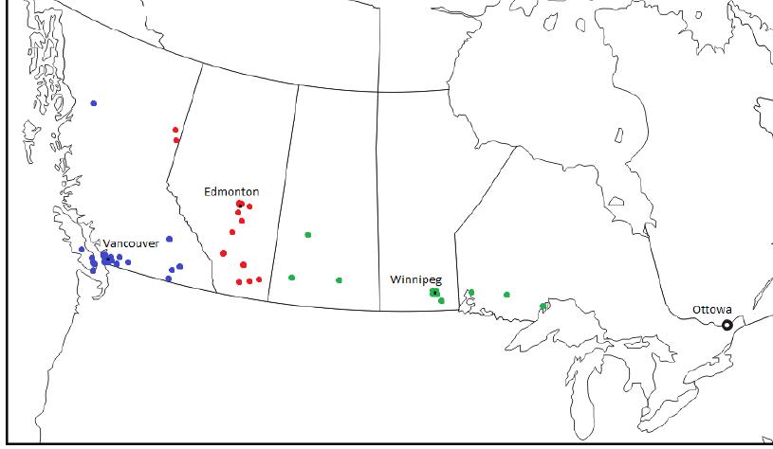
Store location
Color codes for retailer distribution division.

Slide 14
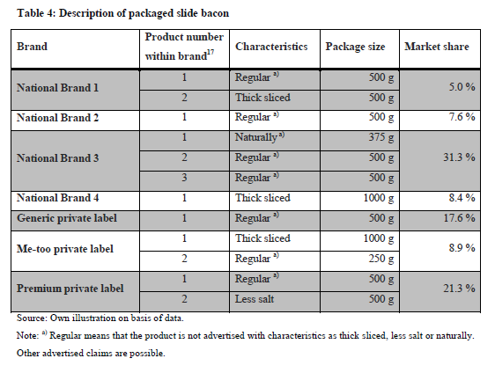
Case study 1: packaged sliced bacon
Notes:
Diversified market share = multiple players
Premium PL has 22% of market

Slide 15
Bacon: Retail and wholesale prices (C$/100g)
Notes:
Note:
Volatile input prices / commodity market for both NB and PL BACON

Slide 16
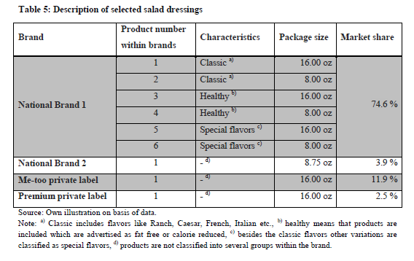
Case study 2: Bottled salad dressing
Notes:
Dominant NB leader wit 75% share, PL just above 17%.
Premium PL only 2.5% of market

Slide 17
Salad dressing: Retail and wholesale prices (C$/oz.)
Notes:
Flat input prices to retailer -> contracts? Bargaining position?

Slide 18
Brand margins
Bacon |  |  | Salad dressings
Brand | Abs. margin (C$) | Rel. margin (%) | Brand |  | Abs. margin (C$) | Rel. margin (%)
National Brands
NB 1 | 2.33 | 37.7 | NB (16 oz) |  | 0.80 | 25.0
NB 2 | 2.23 | 39.1 | NB (8 oz) |  | 0.80 | 34.0
NB 3 | 2.35 | 38.5
NB 4 | 5.45 | 38.8
Private Labels
PL^{G} | 1.39 | 37.4
PL^{C} (250g) | 1.39 | 41.6 | PL^{C} | 1.41 |  | 53.9
PL^{C} (1000g) | 4.64 | 35.3 | PL^{P} | 1.39 |  | 43.5
PL^{P} | 2.48 | 46.0
Notes:
PL margins beat NBs throughout.
In diff to Kumar/Steenkamp 2007 premium PL margin not higher for dressing!
Premium PL Bacon margin expected.

Slide 19
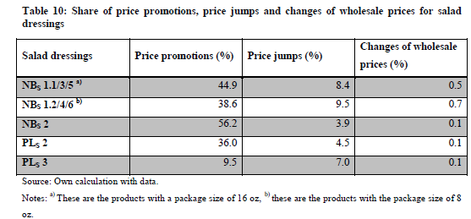
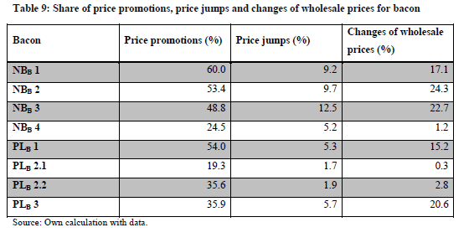
Promotions, jumps adjustments
Notes:
=> Strong evidence of Hi-Lo retailer general pricing – promotion strategy COULD SKIP
German Discounter would have EDLP -> low promotions!
Abbreviations Subscript Bacon or Dressing
First number = Brand – PL 1 = Generic PL 2 = Copycat PL 3 =Premium
Second number = Within Brand

Slide 20
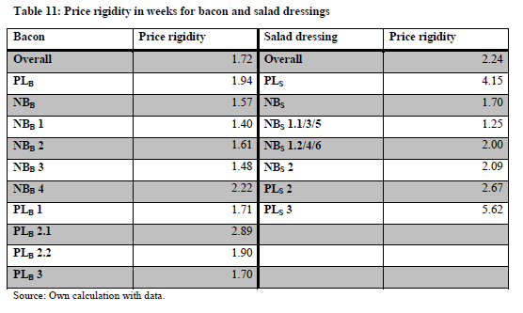
Price rigidity
Notes:
Really low PR in line with existing US studies. Very different from EU studies (25 weeks and up).
-> PL more rigid in bacon and much more in dressing. Premium PL dressing stands out.
-> bacon – NB and PL close
Package size effect for PL bacon 2.1 vs. PL 1.
PL 2.1 larger package (1kg) – NB 1.1/3/5 larger package (16 oz. bottle)

Slide 21
Empirical Model
Linear Model of price rigidity
PR = F(PL^{G}, PL^{C}, PL^{P}, SP^{W}, Z)
Probabilistic model
Y (ΔP=1) = f (PL^{G}, PL^{C}, PL^{P}, ΔP^{W}, ΔP^{W} _{t-i}, Z)
Notes:
Which determinants influence frequency and degree of price adjustments = empirical question!
2 models: #1 linear model of PR #2 probabilistic model of price change
Get hypotheses from Paper p. 8!!!!
PR: price rigidity = mean duration of unchanged price
ΔP: dummy for price change
PL^{G}: dummy for generic
PL^{M}: dummy for me-too product
PL^{P}: dummy for premium PL
SP^{w}: share of changed wholesale prices
ΔP^{w}: dummy for change in wholesale price
ΔP^{w}_{t-i}: dummy for lagged change in wholesale price
Z: vector of control variables: management area, store location, package size, store size, for regression additional price promotions (PROMO) and price jumps

Slide 22
Variables in the analysis

Slide 23
Results
Notes:
Bacon: N for regression 795
Generic and copycat -> higher rigidity, premium PL lower rigidity not expected. Premium does not fill a niche and hence is no differentiator (Kumar Steenkamp 07). Already NB quality bacon. Premium PL placement seems contrary and only has 2.5% share! Probit model is consistent. Magnitudes of effects much weaker than expected. Bottom line – premium bacon may not be a smart placement for the retailer.
Impact of Pw present for bacon. PR ↓ 0.035% for 1% increase in share of Pw changes. In line with Kano 07 and Dutta et al. 02 (used AAC).
Probability of Pw effect increases for same week or next week but decreases for subsequent week. In line with Blinder et al. 98 stating that retailer should adjust price in anticipation of Pw change. HERE, „almost“ immediate pass-through. Retailer competition, cashing in? No consideration of incremental pass-through or Pw↓ vs. Pw↑ effcts. EXTENSION needed.
Dressing: N for regression 650
PR ↑ 85.2 % for me-too and 149 % for premium PL compared to NB (Halvorsen/Palmquist convertion). Probit results supportive. Prob of ∆P ↓ 38.6% for copycat and ↓ 58.3% for premium PL.
But, premium dressing has no higher margin than copycat. Dressing price changes driven by price jumps not adjustments due to flat Pw. No Pw in model due to constant. Retailer pricing strategy clearly at play here. Rigid price for premium PL could be quality signal and/or to pressure premium NB competitor.

Slide 24
Results – Impact of Wholesale Price Movements
Look at impact of wholesale price movements on retail prices
P_{Wholesale} | ∆P_{Retail} | P_{Wholesale} | ∆P_{Retail}
↑ | + | ↓ | +
↑ 1w lag | − | ↓ 1w lag | −
↑ 2w lag | − | ↓ 2w lag | −
↑ 3w lag | + | ↓ 3w lag | −
What is going on?
Long-term, specific contracts?
We did it all wrong?

Slide 25
Conclusions
Prise rigidities differ at brand level and across case study categories
Pricing of vertically differentiated PLs matters to rigidity -> Insights into PL as a strategic weapon
Room for more work ...
P_{Wholesale} story not exciting. No strong impact of P_{w} on retail price movements -> pass-through literature (Nakamura 2008)
Interesting evidence suggesting “long-term contracts“
Significant role of promotions (Hi-Lo pricing)
PL pricing strategies appear category specific. Need focused approach. Little use for aggregate analysis.
Notes:
Nakamura (NBER 2008) “I find that only 16% of the variation in prices is common across stores selling an identical product. 65% of the price variation is common to stores within a particular retail chain (but not across retail chains), while 17% is completely idiosyncratic to the store and product. Product categories with frequent temporary "sales'' exhibit a disproportionate amount of completely idiosyncratic price variation. My results suggest that most of the observed price variation arises from retail-level rather than manufacturer-level demand and supply shocks.”

Slide 26
Estimating Price Rigidity in Vertically Differentiated Product Categories with Private Labels
Milena Bocionek University of Giessen
Sven Anders University of Alberta

Slide 27
References
Baumgartner, J., Glatzer, E., Rumler, F. and A. Stiglbauer (2006): Patterns and Determinants of Price Changes - Analysing Individual Consumer Prices in Austria. WIFO Working Paper, No. 277, Wien, Austria.
Besanko, D., Dubé, J.-P. and S. Gupta (2005): Own-Brand and Cross-Brand Retail Pass-Through. Marketing Sience, Vol. 24, No. 1, pp. 123-137.
Blinder, A. S., Canetti, E. R. D., Lebow, D. E. and J. B. Rudd (1998): Asking about Prices: A New Approach to Understanding Price Stickiness. New York, USA: Russel Sage Foundation.
Bontemps, C., Orozco, V. and Vincent Réquillart (2008): Private Labels, National Brands and Food Prices. Review of Industrial Organization, Vol. 33, No. 1, pp. 1-22.
Chevalier, J. A., Kashyap, A. K. and P. E. Rossi (2003): Why Don’t Prices Rise During Periods of Peak Demand? Evidence from Scanner Data. The American Economic Review, Vol. 93, No. 1, pp. 15–37.
Chintagunta, P. K., Bonfrer, A. and I. Song (2002): Investigating the Effects of Store-Brand Introduction on Retailer Demand and Pricing Behavior. Management Science, Vol. 48, No. 10, pp. 1242-1267.
Cotterill, R, W., Putsis, W. P. and R. Dhar Jr. (2000): Assessing the Competitive Interaction between Private Labels and National Brands. The Journal of Business, Vol. 73, No. 1, pp. 109-137.
Dutta, S., M. Bergen and D. Levy (2002): Price Flexibility in channels of distribution: Evidence from scanner data. Journal of Economic Dynamics & Control, Vol. 26, No. 11, pp. 1845-1900.

Slide 28
References
Eichenbaum, M., Jaimovich, N. and S. Rebelo (2011): Reference Prices, Costs, and Nominal Rigidities. American Economic Review, Vol. 101, No. 1, pp. 234-262.
Herrmann, R., Möser, A. and S. Weber (2005): Price Rigidity in the German Grocery-Retailing Sector: Scanner-Data Evidence on Magnitude and Causes. Journal of Agricultural & Food Industrial Organization, Vol. 3, No. 1, pp. 1-35.
Herrmann, R., Möser, A. and S. Weber (2009): Grocery Retailing in Germany: Situation, Development and Pricing Strategies. Working Paper for the Center for International Development and Environmental Research, No. 41, Giessen, Germany.
Kano, K. (2007): Essays on Retail Price Movements. Dissertation at the University of British Columbia, Vancouver, Canada.
Levy, D., M. Bergen, S. Dutta, und R. Venable (1997): The Magnitude of Menu Costs: Direct Evidence from Large U.S. Supermarket Chains. Quarterly Journal of Economics, Vol. 112, No. 3, pp. 791-825.
Levy, D., Lee, D., Chen, H. A., Kauffman, R. J. and M. Bergen (2011): Price Points and Price Rigidity. The Review of Economics and Statistics, Vol. 93, No. 4, pp. 1417–1431.
Meza, S. and K. Sudhir (2010): Do private labels increase retailer bargaining power? Quantative Marketing Economics, Vol. 8, No. 3, pp. 333–363.

Slide 29
References
Morton, F. S. and F. Zettelmeyer (2000): The Strategic Positioning of Store Brands in Retailer-Manufacturer Bargaining. Review of Industrial Organization, Vol. 24, No. 2, pp. 161–194.
Owen, A. and D. Trzepacz (2002): Menu costs, firm strategy, and price rigidity. Economic letters, Vol. 76, No. 3, pp. 345-349.
Powers, E. and N. J. Powers (2001): The Size and Frequency of Price Changes: Evidence from Grocery Stores. Review of Industrial Organization, Vol. 18, No. 4, pp. 397–416.
Steiner, R. L. (2004): The Nature and Benefits of National Brand/Private Label Competition. Review of Industrial Organization, Vol. 24, No. 2, pp. 105–127.
The Nielsen Company (2011): The Rise of the Value-Conscious Shopper - A Nielsen Global Private Label Report. Published at: http://www.hk.nielsen.com/documents/ PrivateLabelGlobalReport.pdf.
Volpe, R. J. (2010): Price and Promotional Patterns at Major US Supermarkets. Dissertation at the University of California, Davis, USA.
Weber, S. (2009): Ausmaß und Determinanten von Preisrigiditäten im deutschen Lebensmitteleinzelhandel: Eine empirische Analyse mit Scannerdaten. Dissertation at the Justus Liebig University, Giessen, Germany.

