Slide 1
Investment, structure and risk in Canadian agriculture
David Sparling, PhD
Chair of Agri-Food Innovation
Nicoleta Uzea & Erin Cheney
Research Associates
Richard Ivey School of Business

Slide 2
Topics
Farm level income & investment
Large, commercial farms
The role of social media in new products
Risk balancing - The relationship between business risk and financial risk

Slide 3
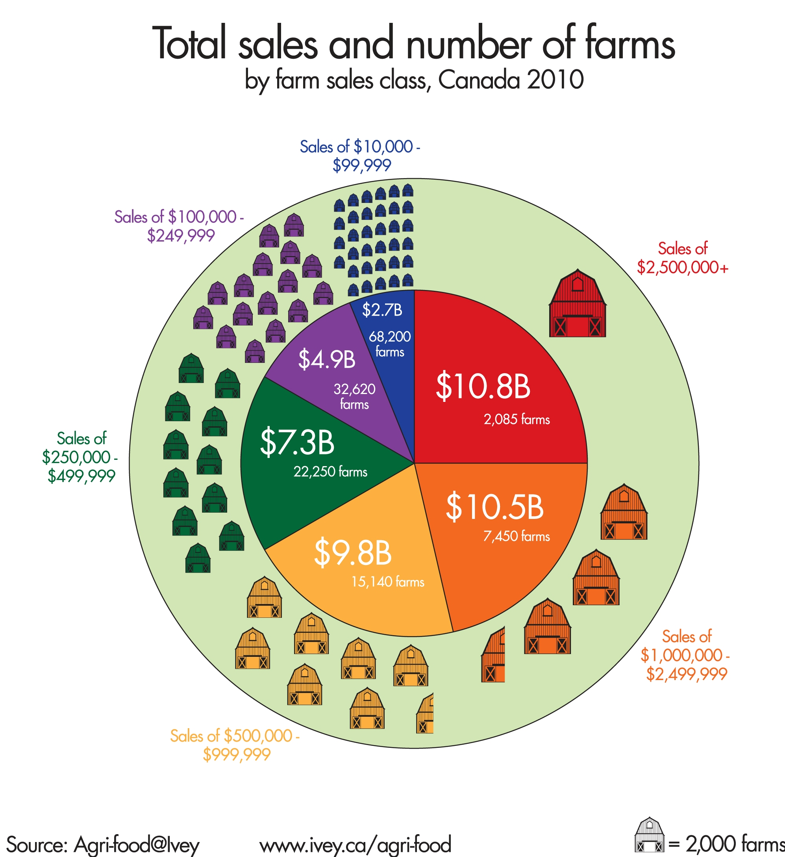
A snapshot of Canadian agriculture by sales class and share of sales

Slide 4
Major changes between 2005 and 2010
Sales 41%
Net income 126%.
Assets 45%
Net worth 47% - average $486,000/farm
  Increases ranged from $190,000 for farms selling less that $100,000 per year
  to over $1.9 million for farms selling > $2.5 million/yr.
Government payments 9%.

Slide 5
Income has improved for farmers
Average net farm income by sales class, Canada, 2005-2010
Sales Class

Slide 6
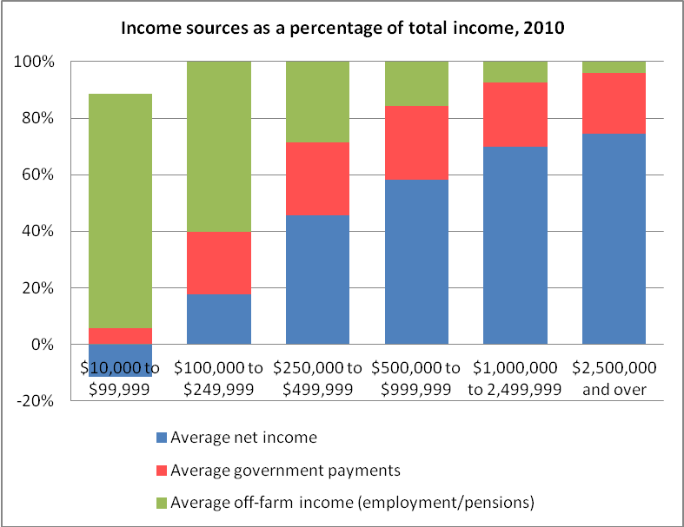
Off-farm income supports smaller farms

Slide 7
Key measures and ratios
 | 2010
 | $10,000 - $99,999 | $100,000 - $249,999 | $250,000 - $499,999 | $500,000 - $999,999 | $1,000,000 - 2,499,999 | $2,500,000 - over
Average total assets | $779,801 | $1,448,202 | $2,145,917 | $3,557,161 | $5,920,716 | $14,101,584
Average net income | -$6,633 | $9,559 | $41,583 | $88,628 | $192,251 | $579,930
Assets/dollar of Sales | $20.05 | $9.69 | $6.54 | $5.48 | $4.21 | $2.72
Return on Assets | -0.9% | 0.7% | 1.9% | 2.5% | 3.2% | 4.1%
Return on Sales | -17.1% | 6.4% | 12.7% | 13.7% | 13.7% | 11.2%
Return on Equity | -0.9% | 0.8% | 2.4% | 3.2% | 4.4% | 5.7%

Slide 8
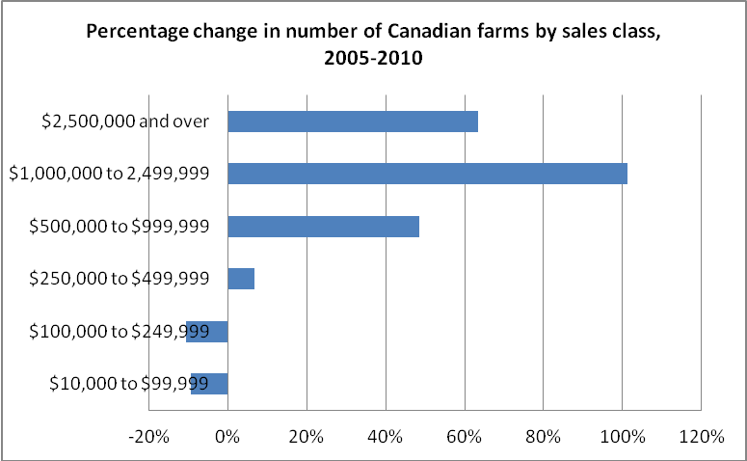
A shift to larger farms by sales
(driven somewhat by higher prices)

Slide 9
II. How do farmers invest?
Farmers invested almost $11.5 B in 2009
Provides an indicator
  Current income and profitability
  Farmer optimism about their future
  Of industry shifts
Data source – Farm Financial Survey 2009
– not collected in 2010

Slide 10
Propensity to invest

Slide 11
Investment is heavily scale dependent

Slide 12
Regressions – Farm investment and …
Relationship between farm investment and … | $10,000 - 99,999 | $100,000 - 249,999 | $250,000 - 499,999 | $500,000 - 999,999 | $1,000,000 - 2,499,999 | $2,500,000+
net operating income | 0.52 | 0.81* | 0.50 | 0.11 | 0.48 | 0.17
off-farm income | -0.44 | -0.47 | -0.88* | 0.63 | 0.85* | -0.15
government payments | -0.02 | -0.32 | -0.02 | -0.53 | 0.46 | 0.89*
debt level | -0.38 | -0.95* | -0.89* | -0.19 | -0.15 | 0.85*

Slide 13
How it the total investment split?

Slide 14
Share invested in machinery, land and houses is growing; the rest are declining
Type of Asset |  |  | % of
 | 2001 | 2009 | 2009
Farm machinery & equipment | $3,583 | $5,441 | 47.6%
Farm real estate | $1,312 | $2,290 | 20.0%
Building constr/major renov. | $1,113 | $1,303 | 11.4%
House constr/major renov | $308 | $638 | 5.6%
Quota | $642 | $536 | 4.7%
Stocks, bonds, GICs, mutual funds | $306 | $389 | 3.4%
Breeding & replacement livestock | $575 | $346 | 3.0%
Land improvements | $237 | $280 | 2.4%
Manure, chemical or fuel storage or reno. | $139 | $182 | 1.6%
Environmental protection improvements | $32 | $34 | 0.3%
Total Investments | $8,247 | $11,439

Slide 15
III. How do large farms operate?
- 14 in-depth case studies of large and complex farms
- $ 1 million in sales – but most much larger
Provinces
Sectors
Ontario
Manitoba
Alberta
Saskatchewan
Hog
Flowers
Sod
Dairy
Cash crops
Mixed operation (crop & cattle)
Specialty crop
Greenhouse vegetable
Fruit & Vegetable
Notes:
This report was prepared for Agriculture and Agri-Food Canada and examined the opportunities, challenges and strategies of large, complex agricultural businesses in Canada.
The project examined 14 large farms across Canada and across sectors using a case study method involving semi-structured interviews with the CEOs of the operations and in some cases other senior staff. Other publicly available data was also used.
The purpose of the study was
to understand how the farms grew to their present size,
the strategies employed to keep their business competitive and
the opportunities and challenges they face moving ahead.
The sample was relatively diverse though we acknowledge the limited geographic spread of the sample set.
In total 9 sectors across 4 provinces were included with sales ranging from $1-million to $20-million.

Slide 16
Primary strategies
Scale, capacity utilization and growth
Vertical integration
Product differentiation
Diversification
Notes:
Our report provides a breakdown of each business model while trying to identify commonalities wherever possible. But as is often the case business models are unique and it can be challenging to group them given the intrinsic nuances to any business. As such we looked to the most significant drivers within the case studies and found we could group the sample into 4 categories.
First was Scale and capacity utilization. In 6 of the 14 cases farms were using scale to maximize revenue and optimize their balance sheet which tended to be heavily weighted with assets such as land, quota and new equipment. Farm sectors included fruit and vegetable growers, mixed farms and the supply managed farms.
Vertical integration was the second driver – in two cases this strategy was followed and led to improvements in customer service and scaled growth. We saw cases of both forward and back integration – a butcher back integrating into production and processing and a crop share partnership that over many years grew into a full-service, multiple site elevator.

Slide 17
Large farms operate at many levels of the value chain
Farm | Genetics | Input supply | Primary production | Processing | Distribution | Wholesale | Retail | Exports | Services
1
2 |  | P | P - minor products
3 | P
4
5 |  | P
6 |  |  |  | P | P | P |  | P
7
8
9 |  |  |  |  |  |  |  | P
10 | P |  | P – minor products
11 |  | P | P but now sole
12 | P |  | P but now sole
13
14 |  | P
Notes:
The farms studied operated at many different levels of the chain.

Slide 18
Partnerships were paramount
Market access
Managing risk
Growth
Sharing resources
Distribution
Commercialization
Land investment
Main focus or objective of the partnerships

Slide 19
Innovative and aggressive
Willingness to experiment & learn from others
  With production
  With products and markets
Always at leading edge
Managed their risks
Leverage – didn’t feel the need to own all the assets they used in their businesses

Slide 20
Tweet Eats
The Construction of Taste in Online Social Media Networks
Melissa Leithwood
PhD Candidate
Richard Ivey School of Business

Slide 21
Research Question
How do individual roles evolve through virtual conversation and construct taste?
Motivation
Understanding the role social media plays in generating new products and markets

Slide 22
Method
A unique consumption community for goat product was identified on Twitter
The community inception was captured by the emergence of a marked Twitter hashtag (e.g. #Goaterie).
Its maturation was determined by a large reduction in community participation via posts, which was promoted by the end of a community-wide cooking contest exclusively featuring goat milk, cheese, or meat as the primary ingredient.

Slide 23
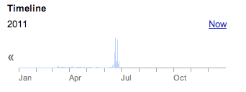
Trending of #Goaterie
#Goaterie was started on March 10, 2011.
On June 19, 2011 a member posted “Did you see the July Bon Appetite? Goat it is!”
This unleashed 1141 posts mentioning #Goaterie over the following two months from
June 19 – August 25, 2011.
Almost one hundred times (98.5%) as many posts as the community experienced over the
Previous three months (from March 10 – June 18, 2011 only 17 #Goaterie posts existed).

Slide 24
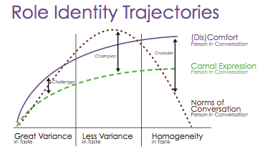
Findings:
Notes:
Findings

Slide 25
Conclusion
Virtual conversations encourage consumption by making each individual consumer believe they do it for unique reasons.
Despite homogenization of taste, individual consumption patterns change as a reflection of the virtual role identity they express.

Slide 26
Thank you
David Sparling
dsparling@ivey.ca
www.ivey.ca/agri-food
Twitter - @iveyagrifood
The Chair of Agri-Food Innovation is supported by the Agricultural Adaptation Council

Slide 27
BRM payments and risk balancing:
Potential implications for financial riskiness of Canadian farms
Nicoleta Uzea, Richard Ivey School of Business
Kenneth Poon, University of Guelph
David Sparling, Richard Ivey School of Business
Alfons Weersink, University of Guelph

Slide 28
Introduction
BRM programs major component of government-provided subsidy to agriculture
  Margin-based whole farm program (CAIS/AgStab) + ad-hoc payments
  Worries that government program may ‘crowd – out’ private risk management strategies
    Plant riskier crops (Turvey 2012)
    Reduce incentive to use crop insurance (Antón and Kilmura 2009)

Slide 29
Risk Balancing Hypothesis
Gabriel and Baker (1980) suggest operators may manage risk by trading business risk with financial risk
Business Risk + Financial Risk ≤ Total Tolerable Risk
Business risk = volatility in income
Financial risk = level of leverage

Slide 30
Implications of Risk Balancing for the Effectiveness of BRM Programs
If farmers indeed balance BR and FR, BRM programs (assuming they do reduce BR) may lead farmers to take on more FR than they would otherwise
This increases the risk of equity loss
Do BRM programs crowd out farmers’ financial risk management strategies?
No studies have looked at the extent of risk balancing on Canadian farms and the impact of BRM payments on the likelihood of risk balancing

Slide 31
Research Problem
Is there empirical evidence to suggest BRM programs crowd out farmers' financial risk management strategies?

Slide 32
Data
Ontario Farm Income Database (OFID)
  Tax + production data on Ontario CAIS/AgriStability participants
    Detailed income and expenses
    Unique farm ID → panel data possible (2003 to 2010)
    Focus on 3 sectors: Field Crops, Dairy, Beef
Sector | Field Crops | Dairy | Beef
Number of farms in panel data | 3,860 | 236 | 1,854

Slide 33
Business Risk vs Financial Risk
Measuring Business Risk (BR)
Measuring Financial Risk (FR)
Theory | OFID measure
 | Coefficient of Variation: Earnings Before Interest and Tax (3 years)*
* First BR measure looks at volatility of income in 2003-2005
Theory | OFID measure
 | Interest expense . Earnings Before Tax

Slide 34
Measuring the Extent of Risk Balancing
Correlation analysis
  Per farm: correlate between 5 pairs of BR and FR measures (2003-2005 BR to 2006 FR)
  Spearman’s rank-order correlation – chosen to go around negative values for BR and FR
  Extent of risk balancing behaviour = share of farms with negative significant correlation

Slide 35
Extent of risk balancing
224 crop farms (5.80%) & 11 dairy farms (4.66%) with significant negative correlation
  Small number of pairs means correlation values has to be
  very high to be significant (≤ -0.9)

Slide 36
Factors Associated with Risk Balancing
What Is the Impact of BRM Payments?
Risk balancing: Looking at movement of BR and FR over time
  If BR goes down from 05-06, does FR go up from 06-07?
Estimated logit (random effects and fixed effects) and probit (random effects) models
Dependent Variable
RISK_BAL if FR moves in opposite direction of BR in previous period: 1 Otherwise: 0

Slide 37
Independent Variables
Enterprise Diversity: Herfindahl Index of enterprise revenue (from crop, beef, hogs, etc)
Operating profit margin: $ of net income per $ of revenue
Operating expense ratio: $ of expense per $ of revenue
Interest expense: (in 100,000s)
BRM payments: (in 100,000s) based on year they received money
Partnership (dummy): if farm has more than 1 operator: 1, otherwise 0
Size category (dummies) by dollar of sales | Field Crop Farms | Dairy Farms
 | $0-$10k | $0k-$250k
 | $10k-$100k | $250k-$500k
 | $100k-$250k | +$500k
 | $250k-$500k
 | +$500k

Slide 38
Regression results

Slide 39
Main findings
Program payments may crowd out farm’s risk balancing strategy
  Farms that received more payments less likely to risk balance
  BUT, may be sector-specific
Other factors that influence risk balancing behaviour also seems to be sector specific
  Interest expense influence behaviour for field crop operations but not for dairy
  Larger field crop farms more likely to risk balance, but size have no effect for dairy operations

Slide 40
Next steps & Challenges
Next Steps:
Extend analysis to other sectors (beef)
Challenges:
OFID is detailed in tax & production data but does not capture balance sheet information
  Especially important in capturing value of asset (land, quota)

Slide 41
Thank You

Slide 42
Appendix – Field Crop Results

Slide 43
Appendix – Dairy Results

Slide 44
How much are they investing?
Total earnings, investment, and debt by revenue class, 2009
Revenue Class | Number of farms | Sales ($ Million) | Net operating income ($ Million) | Gov’t payments ($ Million) | Investments ($ Million) | Debt (in $ Million)
$10,000 - 99,999 | 73,210 | $2,887 | -$534 | $244 | $1,104 | $4,633
$100,000 - 249,999 | 31,560 | $4,818 | $233 | $334 | $1,439 | $5,766
$250,000 - 499,999 | 22,540 | $7,468 | $846 | $448 | $1,927 | $9,171
$500,000 - 999,999 | 14,210 | $9,410 | $1,233 | $449 | $2,541 | $10,417
$1,000,000 - 2,499,999 | 7,065 | $9,812 | $978 | $491 | $2,699 | $10,793
$2,500,000+ | 2,095 | $11,476 | $735 | $414 | $1,731 | $7,916
Total | 150,680 | $45,871 | $3,490 | $2,380 | $11,441 | $48,696

Slide 45
And smaller farms are pulling back

